Slide 1
화폐의 필수적 역할 김영식 (서울대 경제학부)

Slide 2
1. 화폐의 본질과 속성 (1) “불신은 모든 화폐의 근원이다.” (2) “화폐는 기억이다.” (3) 화폐의 역사와 신뢰 문제 2. 전자화폐(digital cash)와 비트코인 (1) 왜 ‘digital cash’가 필요한가? (2) digital cash와 신뢰 문제 (3) 비트코인의 역사적 선례: Stone Money of Yap Island

Slide 3
참고문헌
Berentsen and Schar (2018) “An Introduction to the World of Cryptocurrency”, Federal Reserve Bank of St. Louis.
Jevons (1875) Money and the mechanism of exchange, New York: D. Appleton and Co.
Furness, The Island of Stone Money, Uap of the Carolines (Philadelphia: J. B. Lippincott Company, 1910).
Kiyotaki and Moore (2002) “Evil is the root of all money” American Economic Review, 92(2): 62-66.
Kiyotaki and Wright (1989) “On money as a medium of exchange” Journal of Political Economy 97(3-3): 927-954.
Kocherlakota (1998) “Money is memory” Journal of Economic Theory, 81(2): 232-51.

Slide 4
1. 화폐의 본질과 속성 (1) “불신은 모든 화폐의 근원이다.” (2) “화폐는 기억이다.” (3) 화폐의 역사와 신뢰 문제 2. 전자화폐(digital cash)와 비트코인 (1) 왜 ‘digital cash’가 필요한가? (2) digital cash와 신뢰 문제 (3) 비트코인의 역사적 선례: Stone Money of Yap Island

Slide 5
1. 화폐의 본질과 속성
화폐의 필수적 역할(essentiality)을 요약하는 두 명제
Kiyotaki and Moore (2000):
“불신”은 모든 화폐의 근원이다.
(Evil or distrust is the root of all money.)
Kocherlakota (1998):
화폐는 “기억”이다.
(Money is memory.)

Slide 6
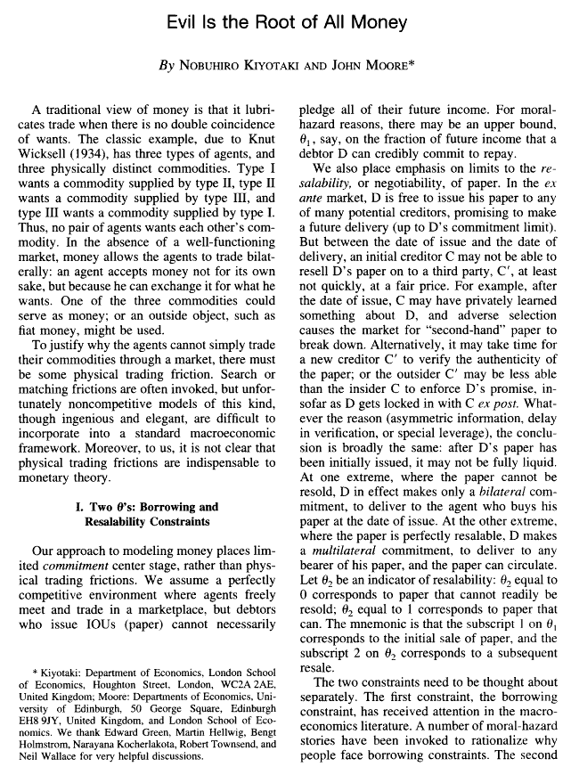

Slide 7
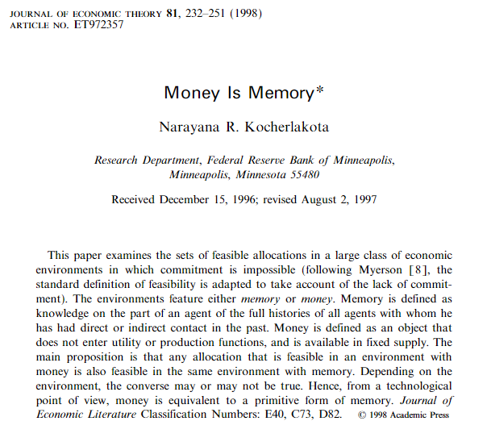

Slide 8





1. 화폐의 본질과 속성
욕망의 이중적 불일치 (absence of double coincidence of wants)
수요
어부
축산업자

Slide 9




1. 화폐의 본질과 속성
양자 간 계약이행 (bilateral commitment)
어부
차용증서(IOU)
(비양도성)
수요
농부
축산업자

Slide 10

1. 화폐의 본질과 속성
양자 간 불완전 계약이행 & 완전 기록(complete record keeping)
어부
거래장부
차용증서
(비양도성)
수요
농부
축산업자

Slide 11
1. 화폐의 본질과 속성
다자 간 계약이행(multilateral commitment)
어부
차용증서
(양도성)
수요
농부
축산업자

Slide 12
1. 화폐의 본질과 속성
다자 간 불완전 계약이행 & 완전 기록 (complete record keeping)
어부
거래장부
차용증서
(양도성)
수요
농부
축산업자

Slide 13
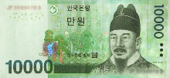
1. 화폐의 본질과 속성
불완전 계약이행 & 불완전 기록 & 법정화폐
어부
화폐
수요
농부
축산업자

Slide 14
1. 화폐의 본질과 속성
(1) “불신”은 모든 화폐의 근원 (Evil is the root of all money)
일반적으로 구매자 (buyer)와 판매자 (seller) 간 시차를 둔 대차거래 (intertemporal trade)에서 사후적으로 완전한 채무이행 (full commitment)을 보장하지 못하는 신뢰(trust) 문제가 존재함.
이때 구매자가 판매자로부터 받은 재화의 대가로 (정부 또는 중앙은행에 의해 신뢰가 형성되어 있는) 화폐를 지급한다면 거래가 성사될 수 있을 것임.
신뢰 문제가 없다면 화폐 또한 반드시 필요하지 않다는 것을 의미한다는 점에서 “불신(distrust)이 화폐의 근원” 이라는 것임.

Slide 15
1. 화폐의 본질과 속성
(2) 화폐는 “기억” (Money is memory)
구매자와 판매자 간 대차거래 기록이 모든 사람들 사이에 공적으로 유지∙관리될 수 있다면 채무불이행 시 이 기록에 근거하여 처벌을 받게 될 것이므로 의도적 채무불이행과 같은 신뢰의 문제는 해결될 수 있음.
그러나 이러한 공적 거래 기록이 없는 상황에서는 판매자가 구매자로부터 받은 화폐가 과거 판매자∙구매자 간 거래의 증거이기 때문에 실질적으로 공적 거래 기록을 대체할 수 있음.
화폐가 공적 거래 장부 또는 거래기억의 역할을 함
일반적으로 공적 거래 기록의 유지 및 관리가 불완전하거나 비용이 발생하고 화폐 보유도 기회비용이 수반되기 때문에 공적 거래 기록을 이용한 신용거래와 화폐가 각각 서로를 완전히 대체하기 보다는 상호 공존하는 것이 보통임.

Slide 16
1. 화폐의 본질과 속성
(3) 화폐의 역사와 신뢰 문제 : 금속화폐
The oldest method to resolve the trust problem among strangers is by minting coins in precious metals.
Trust in coins was also increased when the king in most countries, promised to accept his own coins as payment for tax collection and so on.
In this way, the holder of a coin knew that the money could be used in the future at a particular value and that in a worst case scenario, if the king broke his promise, the coins had a metal value. “debasement”

Slide 17
1. 화폐의 본질과 속성
(3) 화폐의 역사와 신뢰 문제: 은행권(bank note)
The trust was then shifted from the precious metals in the coin to commercial banks storing the precious metals and issuing paper banknote that can be redeemed for precious metals.
Once a bank had begun issuing more banknotes than they had covered for in precious metals, distrust began to spread and people wanted to redeem their banknotes for precious metals, leading to a bank run.

Slide 18
1. 화폐의 본질과 속성
(3) 화폐의 역사와 신뢰 문제: 법정화폐
The banknote monopoly by a central bank then resolved the trust problem.
Unlike commercial banks, a central bank cannot normally go bankrupt.
The holders of a banknote issued by the central bank can normally trust that it will retain its value over time using monetary policy so that they can still use it to pay with in the future.
Together with its legal tender status set by the state, the central bank currency can fulfill the three functions of money: MoE, UoA, SoV

Slide 19
1. 화폐의 본질과 속성
(3) 화폐의 역사와 신뢰 문제: 법정화폐
However, undesirable changes in fiat currency protocols made by political interference are very common and many times have led to the complete destruction of the value of the fiat currency.
Since the Second World War, many central banks have become independent in order to shield them from political interference.
This independence can be taken away by political decisions.

Slide 20
1. 화폐의 본질과 속성
[사례] 통화가치 불안 국가의 신뢰 문제
베네수엘라·짐바브웨에선 비트코인이 '생명줄'
“휴지조각 통화 대신 믿을 만한 안전자산” 인식
비트코인, 짐바브웨에선 안전자산이라고?
로이터통신은 “비트코인은 변동성이 높은 화폐지만 짐바브웨에서는 상황이 다르다”며 “자국 화폐의 변동성이 워낙 크다 보니 비트코인이 화폐가치를 보존하는 용도로 쓰인다”고 설명했다.
이 같은 현상의 배경에는 하이퍼인플레이션 (hyperinflation)이 자리한다. 2억%에 이르는 물가상승률을 감당하지 못한 짐바브웨 정부는 2009년 자국 화폐를 폐지하고 미국 달러를 공식 화폐로 채택했다.
http://www.newspim.com/news/view/20171031000187
http://premium.mk.co.kr/view.php?no=21077

Slide 21
1. 화폐의 본질과 속성
[사례] 통화가치 불안 국가의 신뢰 문제
[Money] 어느 베네수엘라 청년의 비트코인 생존기
https://steemit.com/kr/@sujisyndrome/2xsfd8-money
나는 베네수엘라에서 태어났고, 17살에 끔찍한 경험 끝에 엄마와 함께 미국에 밀입국했다… 가족들은 내가 보내주는 비트코인을 팔아서 생필품을 샀다. 미화 15불에 해당하는 비트코인만 보내줘도 8명 식구가 한달 동안 충분히 생활할 수 있었다. 가족들은 몇 주 만에 돈의 가치가 절반으로 떨어지는 인플레이션을 감안하여 필요한 만큼만 비트코인을 팔았다.

Slide 22
1. 화폐의 본질과 속성 (1) “불신은 모든 화폐의 근원이다.” (2) “화폐는 기억이다.” (3) 화폐의 역사와 신뢰 문제 2. 전자화폐(digital cash)와 비트코인 (1) 왜 ‘digital cash’가 필요한가? (2) digital cash와 신뢰 문제 (3) 비트코인의 역사적 선례: Stone Money of Yap Island

Slide 23
2. 전자화폐(digital cash)와 비트코인
(1) 왜 ‘digital cash’가 필요한가?
Cash is represented by a physical object, a coin or a note.
When this object is handed to another individual, its unit of value is also transferred without the need for a third party to be involved:
No credit relationship arises between buyer and seller.
It is possible for the parties involved to remain anonymous.

Slide 24
2. 전자화폐(digital cash)와 비트코인
(1) 왜 ‘digital cash’가 필요한가?
The great advantage of physical cash is that whoever possesses the physical object is by default the owner of the unit of value.
There is a permissionless access to cash in that any agent can participate in a cash payment system; nobody can be excluded.

Slide 25
2. 전자화폐(digital cash)와 비트코인
(1) 왜 ‘digital cash’가 필요한가?
Cash also has disadvantages:
- Buyers and sellers have to be physically present at the same location in order to trade, which in many situations makes its use impractical.

Slide 26
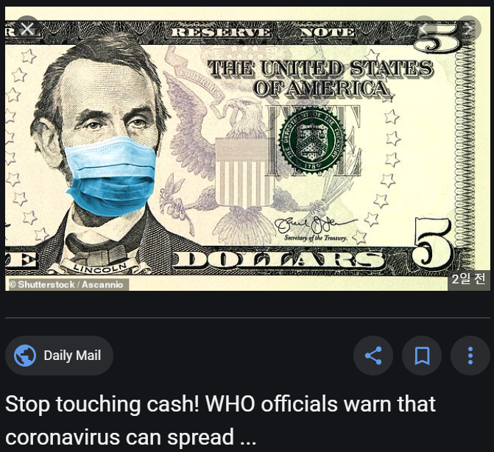
2. 전자화폐(digital cash)와 비트코인

Slide 27
2. 전자화폐(digital cash)와 비트코인
(1) 왜 ‘digital cash’가 필요한가?
An ideal payment system would be one in which monetary value could be transferred electronically via cash data files:

Slide 28
2. 전자화폐(digital cash)와 비트코인
(1) 왜 ‘digital cash’가 필요한가?
In addition to having the advantages of physical cash, it would be able to circulate freely on electronic networks: a data file of this type could be sent via email or social media.
An initial attempt was DigiCash in the 1990s; however, it was not able to establish itself.

Slide 29
2. 전자화폐(digital cash)와 비트코인
(1) 왜 ‘digital cash’가 필요한가?
https://en.wikipedia.org/wiki/DigiCash

Slide 30
2. 전자화폐(digital cash)와 비트코인
(2) ‘digital cash’와 신뢰 문제
A disadvantage of electronic data is that it can be copied any number of times at negligible cost.
If cash data files can be copied and the duplicates used as currency, they cannot serve as a payment instrument.
→ highly undesirable for money
→ This is termed the “double spending problem.”

Slide 31
2. 전자화폐(digital cash)와 비트코인
(2) ‘digital cash’와 신뢰 문제
To counteract the problem of double spending, classical electronic payment systems are based on a central authority that verifies the legitimacy of the payments and keeps track of the current state of ownership.

Slide 32
2. 전자화폐(digital cash)와 비트코인
(2) ‘digital cash’와 신뢰 문제
In such systems, a central authority (usually a bank) manages the accounts of buyers and sellers:
- The buyer initiates a payment by submitting an order.
- The central authority then ensures that the buyer has the necessary funds and adjusts the accounts accordingly.
Centralized payment systems solve the double spending problem.

Slide 33
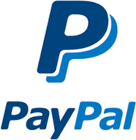
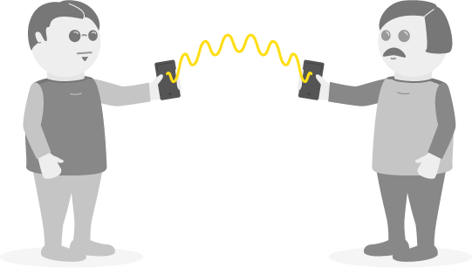
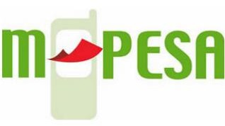
Peer-to-peer payments
https://en.wikipedia.org/wiki/M-Pesa

Slide 34
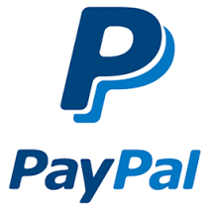
Peer to peer payments:
who guarantees and regulates them?
Credit card companies
Mobile phone companies

Slide 35
2. 전자화폐(digital cash)와 비트코인
(2) ‘digital cash’와 신뢰 문제
A disadvantage of a centralized payment system is that it requires trust that
- the central authority does not misuse the delegated power;
- it maintains the books correctly in any state of the world: that is, the banker is not running away with the money.
Also, centralized systems are vulnerable to hacker attacks, technical failures, and malicious governments that can easily interfere and confiscate funds.

Slide 36
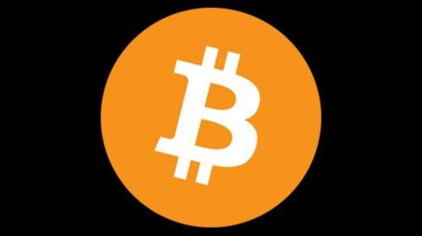
Peer to peer payments:
who guarantees and regulates them?
Credit card companies
Mobile phone companies
Consensus of the network

Slide 37
Why eliminate the “trusted third party”?
No gatekeeper controls access
Could exclude certain agents
Could play favorites, in exchange for side payments
No monopolist transaction fees
No ability to change the ledger arbitrarily
No single point of failure vulnerable to hacking, operator error or hardware failure
No rationing of market hours; available 24-7-365
Greater user control over data

Slide 38
2. 전자화폐(digital cash)와 비트코인
(2) ‘digital cash’와 신뢰 문제
Panel discussion moderated by a New York Times reporter in March 2014:
In response to a conjecture that up to 10% of the bitcoin supply has already been pilfered by computer hackers, bitcoin entrepreneur Andreas Antonopoulos called the 10% theft “a vast improvement over the rest of our economy, where 80% is in the hands of criminals – and that’s the banks.”

Slide 39
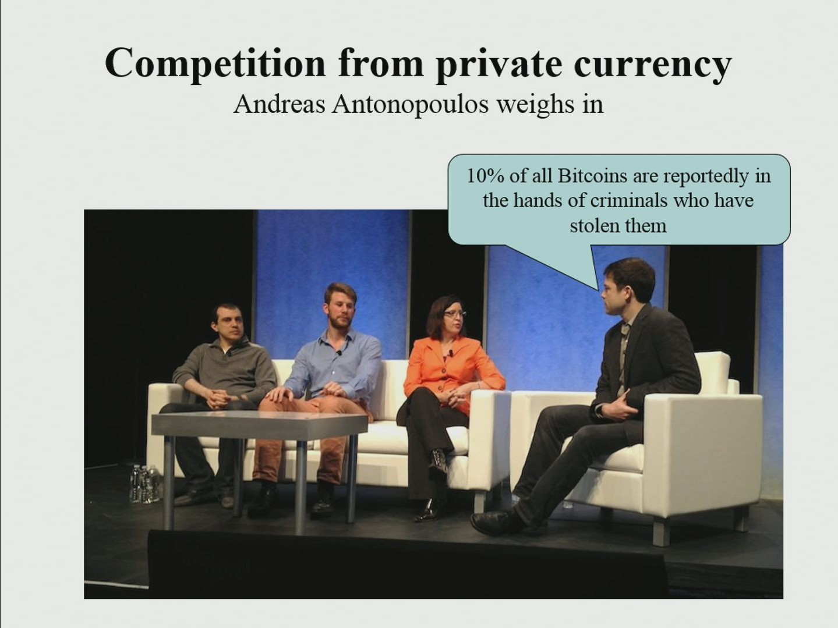

Slide 40
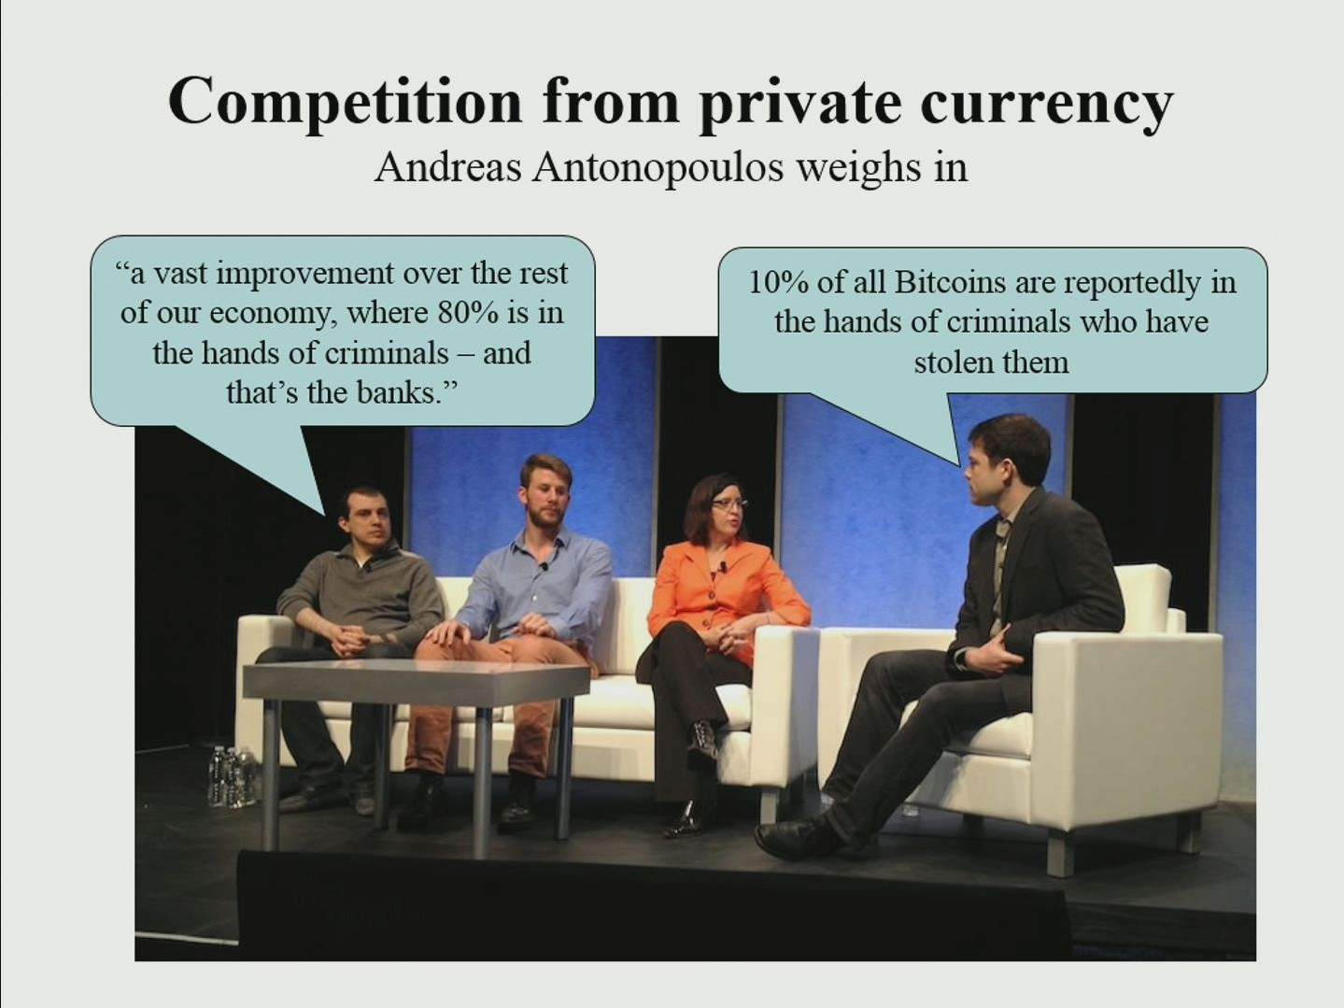

Slide 41
2. 전자화폐(digital cash)와 비트코인
(3) 비트코인의 역사적 선례: Stone Money of Yap Isl
The key feature of the Bitcoin system is the absence of a centrally managed ledger: there is no central authority with an exclusive right to keep accounts.

Slide 42
2. 전자화폐(digital cash)와 비트코인
Stone Money of Yap Island
https://en.wikipedia.org/wiki/Yap

Slide 43
2. 전자화폐(digital cash)와 비트코인
(3) 비트코인의 역사적 선례: Stone Money of Yap Isl
The stones were quarried almost 280 miles away on the island of Palau and brought to Yap by small boats.
Every inhabitant could bring new stone money units into the system.
The money creation costs, in the form of labor effort and equipment such as boats, protected the economy from inflation.

Slide 44
2. 전자화폐(digital cash)와 비트코인
Stone Money of Yap Island
A transaction between a buyer and a seller may require to move the stones (up to 13 feet in diameter) from a buyer’s front yard to a seller’s front yard.
Instead of having to laboriously move the stones, however, the ownership rights were transferred virtually:
- A stone remained at its original location, and the unit of value was detached from it and circulated irrespective of the stone’s whereabouts.
- It was sufficient that all the inhabitants knew who the owner of every stone was.

Slide 45
2. 전자화폐(digital cash)와 비트코인
Stone Money of Yap Island
The Yap system was based on a distributed ledger, in which every inhabitant would keep track of a stone’s ownership.
- When a buyer made a purchase, this person told neighbors that the stone now belonged to the seller.
- The neighbors then spread the news until all of the island’s inhabitants were informed about the change in ownership.
Through this communication, every islander had a precise idea of which unit of value belonged to which person at any point in time.

Slide 46
2. 전자화폐(digital cash)와 비트코인
(3) 비트코인의 역사적 선례: Stone Money of Yap Isl

Slide 47
2. 전자화폐(digital cash)와 비트코인
(3) 비트코인의 역사적 선례: Stone Money of Yap Isl
The Yap payment system is essentially similar to the Bitcoin system.
- Bitcoins are not “traveling” on the Bitcoin network.
- A Bitcoin payment is simply a message that is broadcasted to the network to communicate a change in ownership of the Bitcoin units.

Slide 48
2. 전자화폐(digital cash)와 비트코인
(3) 비트코인의 역사적 선례: Stone Money of Yap Isl
A major difference is that in the Yap system false reports could not be immediately identified, so conflicts regarding the current state of the implicit ledger would have to be argued and settled by the group.
The Yap system was restricted to a group of manageable size with close relationships, in which misconduct could be punished by the group.

Slide 49
2. 전자화폐(digital cash)와 비트코인
(3) 비트코인의 역사적 선례: Stone Money of Yap Isl
In contrast, the Bitcoin system is designed to function in a network where no participant can trust any other participant.
This feature is necessary because it is a permissionless payment system in which participants can remain anonymous through the use of pseudonyms.

Slide 50
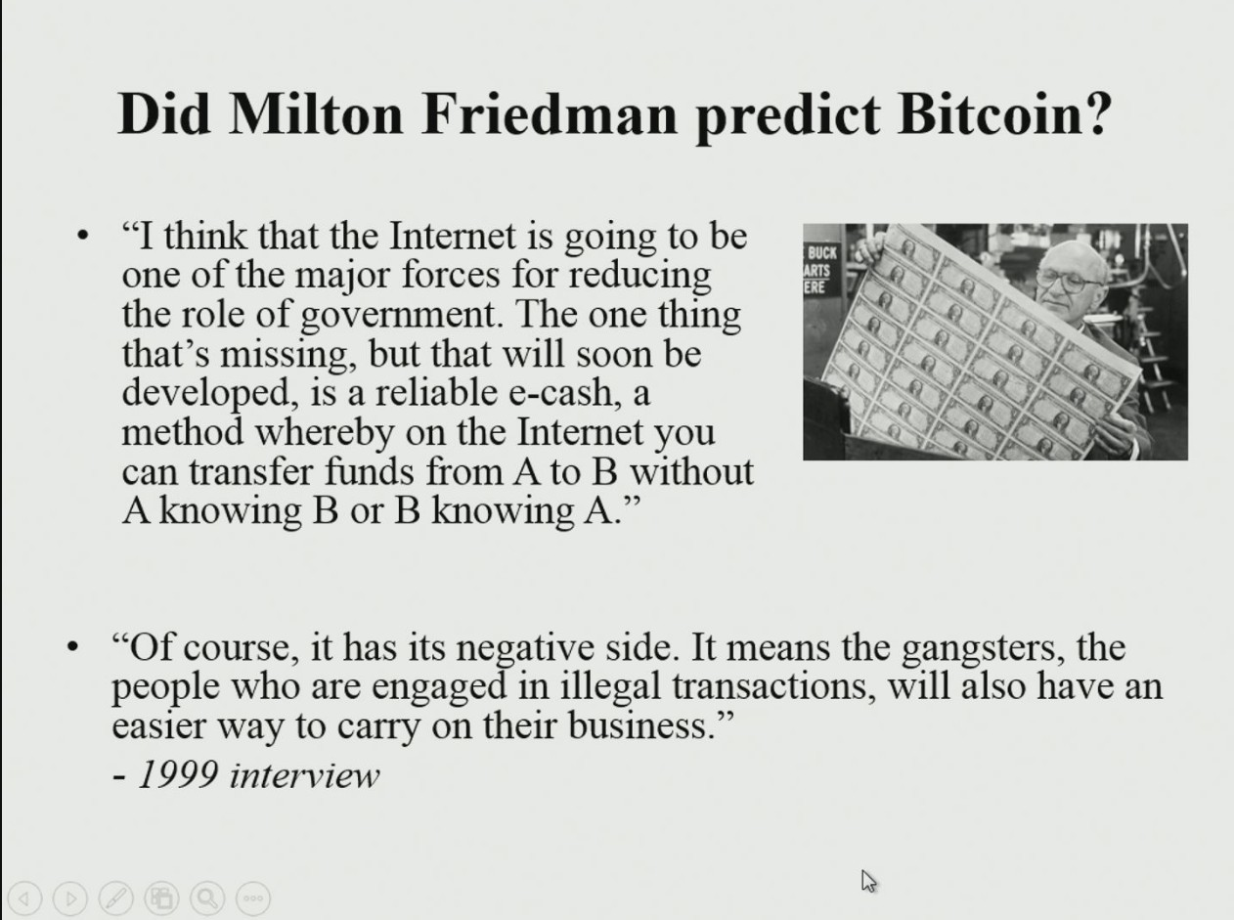
https://www.youtube.com/watch?v=6MnQJFEVY7s

Slide 51
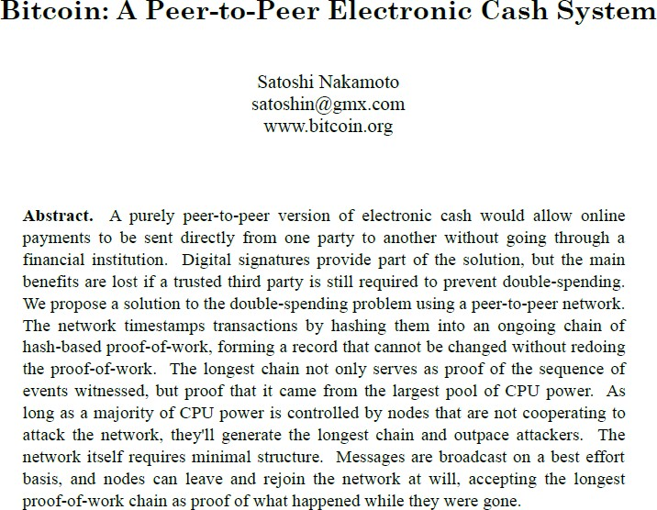
Intelligent redesign of the financial system
Bitcoin network is launched, January 3, 2009

